Slide 1
Lecture 9
Requirements Analysis:
  Requirement Modeling Techniques
BSCS (Software Engineering-I) SZABIST-Islamabad

Slide 2
Activity Diagram
Activity diagram is basically a flowchart to represent the flow from one activity to another activity. The activity can be described as an operation of the system.
The control flow is drawn from one operation to another. This flow can be sequential, branched, or concurrent. Activity diagrams deal with all type of flow control by using different elements such as fork, join, etc
BSCS (Software Engineering-I) SZABIST-Islamabad

Slide 3
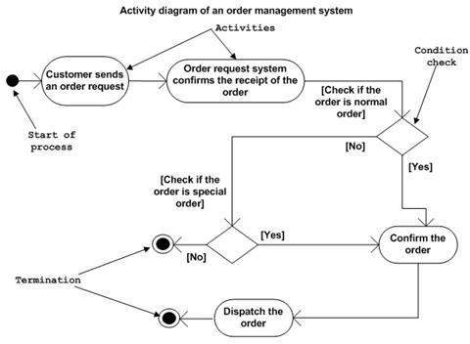
Activity Diagram
BSCS (Software Engineering-I) SZABIST-Islamabad

Slide 4
Drawing Activity Diagram
Drawing an activity diagram, we should identify the following elements −
Activities: The activities are operations of the system.
Association: is the flow
Conditions: are decisions
Constraints: are restrictions
BSCS (Software Engineering-I) SZABIST-Islamabad

Slide 5
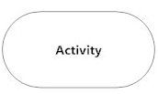

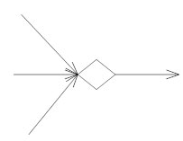
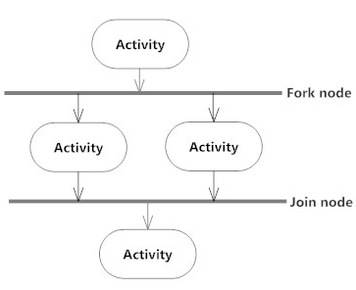

Basic Notations and Symbols
Initial Point
Activity
Action Flow. ...
Decisions….
Branching, Synchronization. ...
Time Event. ...
Merge Event.
BSCS (Software Engineering-I) SZABIST-Islamabad

Slide 6
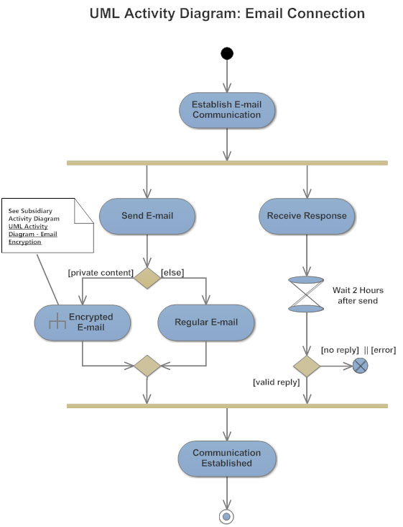
Activity Diagram Example
BSCS (Software Engineering-I) SZABIST-Islamabad

Slide 7
Fork and Branch
Diagrams are read from top to bottom and have branches and forks to describe conditions and parallel activities.
  A fork is used when multiple activities are occurring at the same time.
  A branch describes what activities will take place based on a set of conditions.
  All branches at some point are followed by a merge to indicate the end of the conditional behavior started by that branch.
  After the merge all of the parallel activities must be combined by a join before transitioning into the final activity state.
BSCS (Software Engineering-I) SZABIST-Islamabad

Slide 8
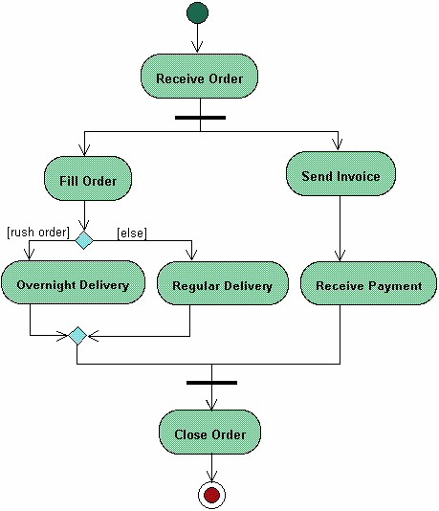
Fork and Branch Example
Start State
Fork
Activity
Branch
Merge
Join
End State
BSCS (Software Engineering-I) SZABIST-Islamabad

Slide 9
Swimlane Diagrams
The swim lane flowchart differs from other flowcharts in that processes and decisions are grouped visually by placing them in lanes. Parallel lines divide the chart into lanes, with one lane for each person, group or sub process. Lanes are labeled to show how the chart is organized.
BSCS (Software Engineering-I) SZABIST-Islamabad

Slide 10

Swimlane Diagrams
BSCS (Software Engineering-I) SZABIST-Islamabad

Slide 11
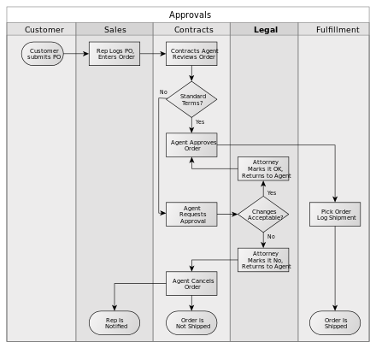
Swimlane Diagrams
BSCS (Software Engineering-I) SZABIST-Islamabad

Slide 12
Swimlane Diagrams
Lets create a Swimlane activity diagram for opening a Lemonade stand.
Let’s create a Swimlane diagram to apply for and get a job when you graduate.
Let’s create a Swimlane diagram for withdrawing money from an ATM. –
BSCS (Software Engineering-I) SZABIST-Islamabad

